Slide 1
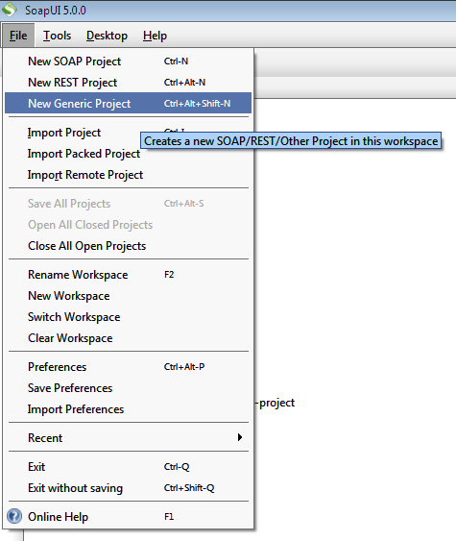

Slide 2
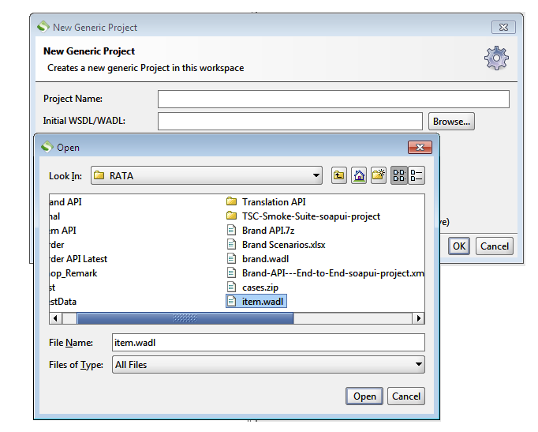

Slide 3
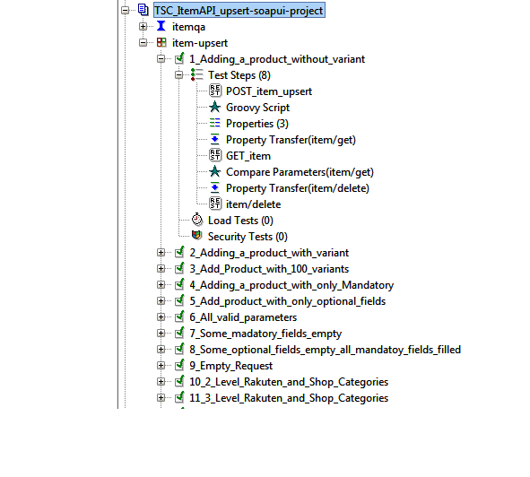
Project Name
TestSuite
Interface
Test Step and Naming Convention
Property transfer, extracting data, operating on the parameters as per requirement
Compare script (Response check)

Slide 4
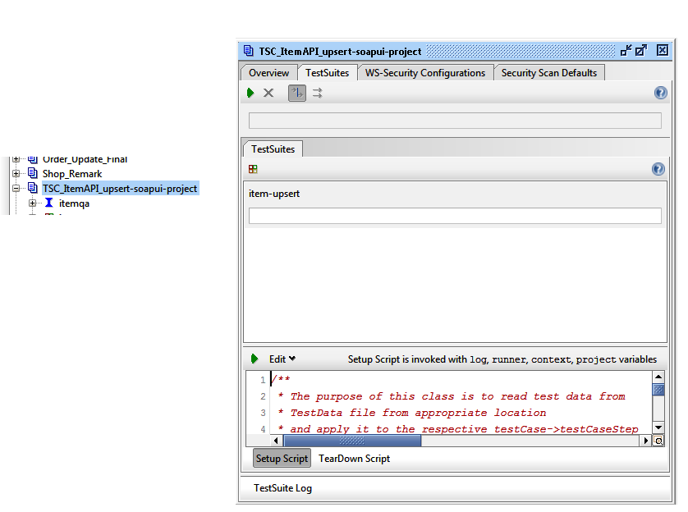
Double Click
Set Up script

Slide 5
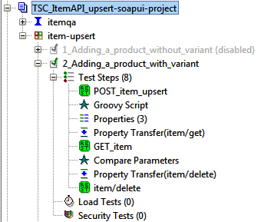
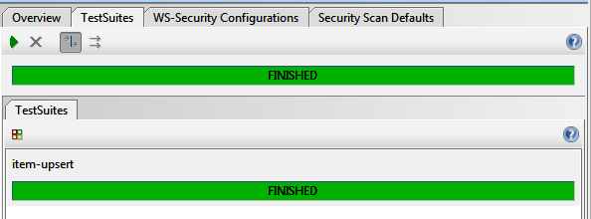


Execute the scripts
Test Data Folder is created when the script is executed

Slide 6
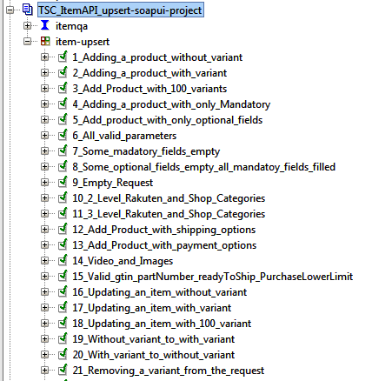
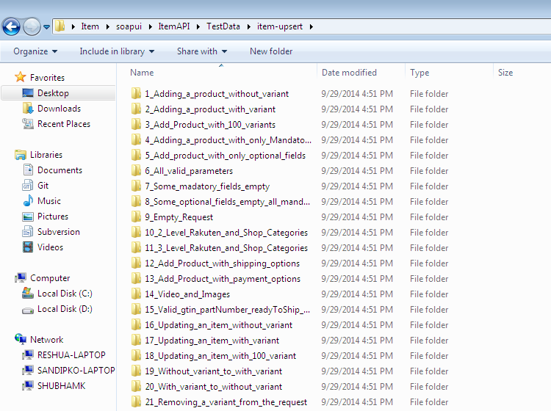

Slide 7
